Slide 1
Title
3 working definitions
The VVA Way to a Commonsense Conceptualisation of Music Visual-Verbal Association and image as metonymic intermediary in the understanding of musical meaning
Philip Tagg Visiting Professor, Leeds Beckett University and The University of Salford (UK)
www.tagg.org
Keynote presentation at conference Transpositions: Music/Image, XIII International Conference of the Department of Musicology, Faculty of Music, University of the Arts, Belgrade, 2016-10-13
This presentation refers to many external media and text files. If you haven’t already done so, open this hyperlink file in order to access those external materials with ease. (That’s because PowerPoint often has problems with embedded media files and direct hyperlinks.) — Please note that some fonts (e.g. phonetic, musical) may not appear correctly on your system. — Media and text file references are indicated in this colour.

Slide 2
If these are answers what are the questions?
but first …..
4½
hours of music heard daily by the average citizen of the urban West*
50%
proportion of daily music dose heard in conjunction with moving images*
amount spent daily on music by average citizen of the urban West*
$3½
*For details see Music’s Meanings, chapter 1 (pp. 35-41)

Slide 3
Everyday visible & invisible music?
P Tagg: Simple semiotics of music
We hear music during 25% of our waking life,
for example (estimated averages in mins. per day)
120 - music on TV, DVD, at movies * (based on Nielsen: 4½ hrs TV/individual/day USA 2005-2006)
30 - shops, restaurants, bars, public places, at religious or sporting events, etc. *
60 - music on radio, music heard at work *
30 - music by conscious choice (home stereo, personal stereo, concerts, clubs, etc.) *
12 - music in video games *
5 – ring tones, ‘hold’ music; signals & chimes, etc. *
= 257 minutes = 4.3 hours per day
>¼ of our waking life
Next: the definitions ...
* See Music’s Meanings, pp. 35-42

Slide 4
1. Music: axiomatic working definition *
Definitions
1. ‘Music’ (1)
[Music is] a type of sonic, non-verbal, human communication which,
according to specific sociocultural conventions,
can carry meaning
related mainly to emotional, gestural, tactile,
kinetic, spatial, prosodic, social and connotative aspects of cognition.
How can music do all of that?
* See Music’s Meanings, pp. 44-50

Slide 5
Domains of representation and music as the ‘embodying’ cross-domain level *
1. ‘Music’ (2)
(anthropological theories of evolution)
emotional
fine motoric
social
‘embodying’ representation
(music)
physical
linguistic
gross motoric
Ian CROSS: “Is music the most important thing we ever did? Music, development and evolution”; Music, Mind & Science. Seoul, 1999.
* See Music’s Meanings, pp. 62-68

Slide 6
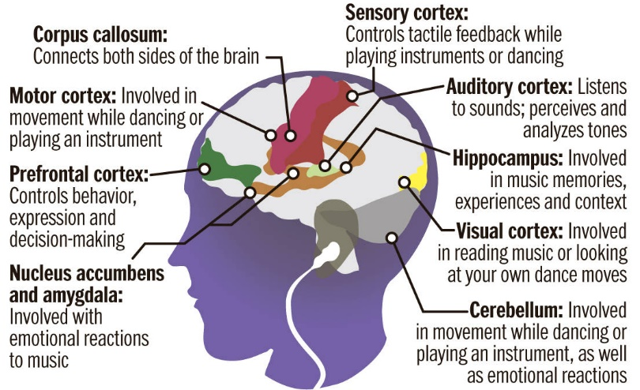
Brain
“Neurons fire up all over the brain”
1. ‘Music’ (3)
Daniel Levithin in Your Brain on Music (2006)
See Music’s Meanings, pp. 68-71

Slide 7
2. VVA — Verbal-Visual Association
Definitions
a response to music expressed in words descriptive of something visible or visualisable.
● countryside | ● British/English | ● gliding | ● green grass
● nature | ● remembering | ● nostalgia | ● melancholy
● pastoral | ● “always has been” | ● calm/secure | ● harmonious
● neutral | ● “life’s like this” | ● piano | ● lyrical
● romantic | ● English production | ● scenery | ● rural
● Beethoven’s Moonlight Sonata | ● French production | ● fields | ● idyll
 | ● Richard Clayderman | ● panorama | ● morning
Play clip ‘Emmerdale Score’ and/or ‘Emmerdale Commutations’ (short)

Slide 8
3. Metonomy, synecdoche, metaphor
Definitions
See Music’s Meanings, pp. 71-80
METONOMY: (μετωνῠμία=change of name) [mE!tOn9mI] figure of speech in which a concept is identified not as itself but by another concept understood as closely related to it.
SYNECDOCHE (συνεκδοχή=simultaneous understanding) [sI!nEkdOkI]: pars-pro-toto expression, e.g. ‘Brussels’ = EU, (Ç) valse on an accordéon musette ≈ Paris 1910s-1950s (even ‘France’ for non-French!).
METAPHOR (μεταφορά=transfer): expression in which the meaning of one concept is transferred or mapped on to another concept, e.g. love is a jewel or love is a battlefield (jewel and battlefield are SOURCES mapped on to the TARGET love).

Slide 9
● countryside | ● British/English | ● gliding | ● green grass
● nature | ● remembering | ● nostalgia | ● melancholy
● pastoral | ● “always has been” | ● calm/secure | ● harmonious
● neutral | ● “life’s like this” | ● piano | ● lyrical
● romantic | ● English production | ● scenery | ● rural
● Beethoven’s Moonlight Sonata | ● French production | ● fields | ● idyll
 | ● Richard Clayderman | ● panorama | ● morning
Neither jewel nor battlefield means love !
VVAs act as metaphors of music because they map visual-verbal sources of meaning on to the music as target.
VVAs are neither ‘the music’ nor ‘translations’ of it. Listeners merely identify small individual connotative ingredients of its integral meaning.

Slide 10
Why are VVAs useful?
1. They help solve the problem of music’s intrinsically alogogenic (=not conducive to verbalisation) nature in an institutionalised tradition of knowledge where the Word (ὁ λόγος) is king (see §4 and end of presentation).
2. They can help solve an important problem of structural denotation in music — poïetic v. aesthesic (next).
3. They can help provide descriptors for parameters of expression sidelined by conventional music theory, e.g. timbre, aural space, vocal persona (after §2).
4. They help counteract conventional fixation on ‘emotion’ or ‘body’ when discussing music’s “content” (after §3).

Slide 11
poïetic / aesthesic
If the audio in slides 13-14 (poïetic/aesthesic 2-3) doesn’t work, go to the hyperlink file and run the video ‘Structural descriptors: poïetic v. aesthesic’ instead of slides 12-14. Then resume this PowerPoint from slide 15 (poïetic/aesthesic 4).

Slide 12
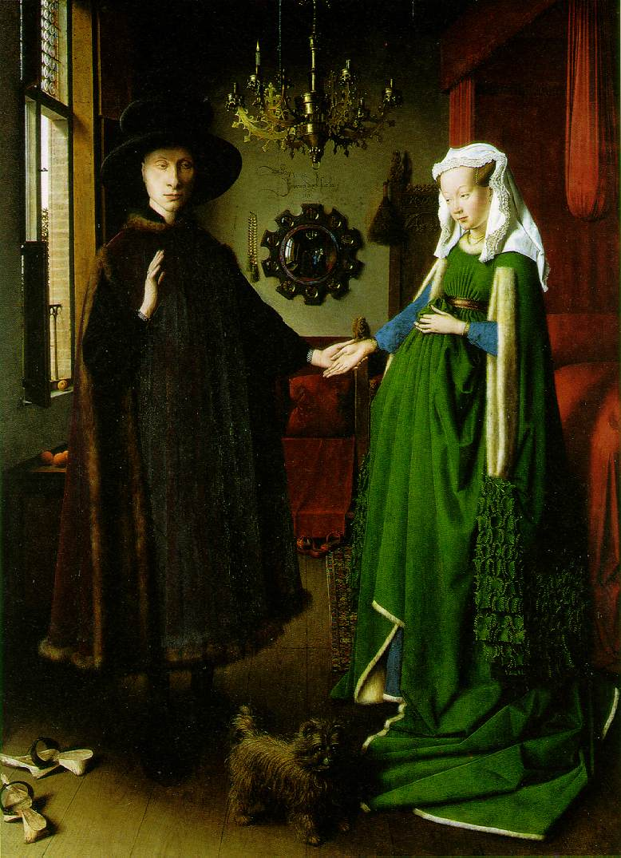
poïetic / aesthesic 1
Van Eyck: The Marriage of Giovanni Arnolfini and Giovanna Cenami; 1434; Oil on wood, 81.8 x 59.7 cm; National Gallery, London.
Denoting structure in visual art
aesthesic descriptor
dog
aesthesic [Is!Ti:zIk] adj. relating to the aesthesis [Is!Ti:sIs]/αἴσθησις, i.e. the perception/sensation of the structure rather than to its production (see poïetic, next).

Slide 13
poïetic / aesthesic 2
Monty Norman (arr. John Barry): 007 (James Bond Theme), 1962: final chord
Denoting structure in music (1)
dog?
No.
Em^{^9}
E minor major nine (E minor triad with added major seventh and ninth)
E minor triad with superimposed B major triad
Tonic minor triad with superimposed dominant major triad
on a Fender Stratocaster (type of electric guitar) treated with slight tremolo and some reverb (also vibraphone)
Poïetic descriptors — poïetic from ποιητικός (≈ productive), i.e. relating to the POÏESIS [pO!Ji:sIs] or PRODUCTION of the [sonic] structure

Slide 14
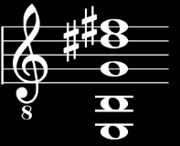
poïetic / aesthesic 3
Monty Norman (arr. Barry): 007 (James Bond Theme), 1962: final chord
Denoting structure in music (2)
Em^9
poïetic term not always essential!
Why not?
Detective chord
Fender Stratocaster (clean, tremolo, reverb); vibraphone
Spy chord
James Bond chord
aesthesic descriptors
V V A s

Slide 15
poïetic / aesthesic 4
Using a real-time counter to unequivocally specify timecode locations of sonic features labelled aesthesically in the James Bond Theme.
Aesthesic label
Timecode location
The slithery mystery motif
The trickster tune
Mystery motif escalation
The danger tune
Big-band swing
Danger stabs
Danger tune chord build-up
The final spy chord
0:01-0:07 (+ at 1:17)
0:07-0:19 (+ at 0:20, 1:20)
0:34-0:40
0:40-0:53 (+ at 0:54)
1:07-1:13
1:14-1:17
1:34-1:39
1:40
Play the James Bond Unequivocal Designation video (hyperlink file, slide #15)

Slide 16
Why are VVAs useful?
1. They help solve the problem of music’s intrinsically alogogenic (=not conducive to verbalisation) nature in an institutionalised tradition of knowledge where the Word (ὁ λόγος) is king (see §4 and end of presentation).
2. They can help solve an important problem of structural denotation in music — poïetic v. aesthesic. ✓
3. They can help provide descriptors for parameters of expression sidelined by conventional music theory, e.g. timbre, aural space, vocal persona (now).
4. They help counteract conventional fixation on ‘emotion’ and ‘body’ as music’s main semiotic content (after §3).

Slide 17
Parameters of musical expression

Slide 18
Parameters of musical expression and storage media
Parameters of musical expression (1)
Parameters
Notation
HiFi stereo recording
Tonality (pitch, register, melody, harmony, etc.)
Timing (tempo, surface rate, rhythm, metre, etc.)
Loudness (dynamics, volume, accentuation, etc.)
Timbre (incl. instrumentation, articulation)
+ vocal persona
Spatiality

Slide 19
Vocal persona (quote)*
Parameters of musical expression (2)
‘[L]isteners who hear voice samples can infer the speaker’s socio-economic status…, personality traits,… and emotional and mental state…
Listeners exposed to voice samples are also capable of estimating the age, height, and weight of speakers with the same degree of accuracy achieved by examining photographs…
Independent raters are also capable of matching a speaker’s voice with the person’s photograph over 75% of the time.’
* Hughes, Susan M et al. (2004). ‘Ratings of voice attractiveness predict sexual behavior’. Evolution and Human Behavior, 25: 295–304

Slide 20
Vocal persona descriptions (quotes)
Parameters of musical expression (3)
Vocal persona characterisations corresponding to
which of these artists?
hard-edged sexual exuberance
Eminem
Wilson Philips
Linda Ronstadt
Buddy Holly
Chaka Khan
Katryna (Nields)
Beverly Sill
impish chirp
Barbie dolls
cuddly vocal personality
nervous teenage male, fearful of rejection
angry smurf
Western mythical girl/woman, heartbroken yet resilient and entirely feminine
Play video ‘79 different vocal personas in 17½ minutes’.

Slide 21
General types of vocal descriptor
Parameters of musical expression (4)
poïetic
how sounds are produced: breathing, control, projection, register, posture, nose, head, chest, diaphragm, etc.
acoustic
volume, dynamics, intensity, partials, transients, fundamentals, amplitude, etc.
aesthesic
perceived traits: sound descriptors, transmodal metaphors, personae
Read Chapter 10 (‘Vocal Persona’) in ‘Music’s Meanings’

Slide 22
Aesthesic voice description categories (1)
Parameters of musical expression (5)
1. Sound descriptors
e.g. babble, bark, bawl, bellow, bleat, boom, chatter, chuckle, chirp, cluck, complain, cry, declaim, denounce, drone, exclaim, gasp, giggle, growl, grumble, gurgle, hoot, howl, hum, laugh, lilt, moan, mumble, mutter, proclaim, rasp, recite, roar, scream, shout, shriek, sigh, snarl, snigger, snort, sob, spit, splutter, squawk, squeak, stammer, stutter, wail, warble, weep, wheeze, whimper, whisper, whistle, whoop, yammer, yap, yell, yelp, etc.
High-pitched, low-pitched, deep, full-throated, gruff, breathy, husky, nasal, gutteral, distinct, indistinct, harsh, muffled, hoarse, shrill, monotone, etc.
2. Transmodal (anaphonic/synaesthetic) descriptors
e.g. sweet, smooth, rough, rounded, sharp, angular, velvety, scratchy, piercing, clean, clear, shaky, wobbly, brassy, grainy, gravelly, etc….
Read Chapter 10 (‘Vocal Persona’) in ‘Music’s Meanings’

Slide 23
Aesthesic voice description categories (2)
Parameters of musical expression (6)
3. Persona descriptors (a-c: d on next slide)
a) Named persons
• Sean Connery, Clint Eastwood, Morgan Freedman; • Billy Holiday, Kate Bush, Björk, etc.
b) Demographic
• man, woman, boy, girl, old, young, middle-aged • language, dialect, regional/class accent, etc.
c) Character descriptions
• cute, cuddly, sweet, nice; • wise, confident, etc.
• melancholy, bored, bland, nondescript, neutral
• willful, determined, brave; • bubbly, cheeky, cheery, jaunty, etc.
• hip, cool, seductive; • sardonic, sarcastic, ironic, nasty, evil
• vulnerable, embarrassed, scared, edgy, nervous, angry, frustrated
• depressed, sad, alienated, anguished, desperate, suicidal, etc., etc.
Read Chapter 10 (‘Vocal Persona’) in ‘Music’s Meanings’

Slide 24
Aesthesic voice description categories (3)
Parameters of musical expression (7)
3. Persona descriptors (d): professions, roles, archetypes
alien, Barbie doll, big boss, bitch, elder, evil child, evil queen,
dirty old man, Druid, fat cat, father, football hooligan, gangster,
geek, guide, heroine, hero, imp, lager lout, miser, monster, mother,
nerd, priest, princess, robot, sissy, soldier, teenager, vamp, villain,
wiseguy, witch, etc.
Read Chapter 10 (‘Vocal Persona’) in ‘Music’s Meanings’

Slide 25
Vocal persona (4)
Parameters of musical expression (8)
3. Vocal costume
cf. swimming costume, actor’s costume, military or school uniform national/regional costume, etc.
costume = something worn, for practical or conventional reasons, to carry out a particular activity, or to show an identity
Spoken costumes
for example • telephone voice (1950s) • ‘interactive’ voice ‘recognition’ (Claire, Julie, Emily, Taxi 8585) • public speaking voice, primary school teacher voice
Sung costumes
for example • bel canto, Wagner soprano, heroic tenor, opera buffa bass • blues shouter, folk singer, crooner, rock yeller/screamer
— Read Chapter 10 (‘Vocal Persona’) in ‘Music’s Meanings’
— Play the ‘Vocal Persona Commutations’ video

Slide 26
Why are VVAs useful?
1. They help solve the problem of music’s intrinsically alogogenic (=not conducive to verbalisation) nature in an institutionalised tradition of knowledge where the Word (ὁ λόγος) is king (see §4 and end of presentation).
2. They can help solve an important problem of structural denotation in music — poïetic v. aesthesic. ✓
3. They can help provide descriptors for parameters of expression sidelined by conventional music theory, e.g. timbre, aural space, vocal persona. ✓
4. They help counteract conventional fixation on ‘emotion’ (and ‘the body’) as music’s main semiotic content.

Slide 27
Music and the emotion (or body) fixation

Slide 28
Canonic ‘emotion’ and ‘body’ quotes
moderating emotion fixation (1)
Passions must be powerful, the musician’s feelings must be unfettered — no mind control,… no pretty little ideas…
[T]he power of pop lies not in its meaning but in its noise,… the non-signifying, extra-linguistic elements that defy “content analysis”: the grain of the voice, the materiality of the sound, the biological effect of the rhythm, the fascination of the star’s body.
Il faut que les passions soient fortes; la tend- resse du musicien doit être extrème ― point d’esprit, point d’épigrammes, point de ces ces jolies pensées.
(Diderot: Le neveu de Rameau, 1762)
(Reynolds, 1990).
[Listening to music the right way means] fully surrendering the spirit to the welling torrent of sensations and disregarding every disturbing thought…
Music excites the body to automatic movement, an exhilaration that defeats boredom and inspires insight… Music gives the body control over itself, granting personal freedom and revealing sexual potential.
(Wackenroder, 1792)
(Lull, 1992)

Slide 29
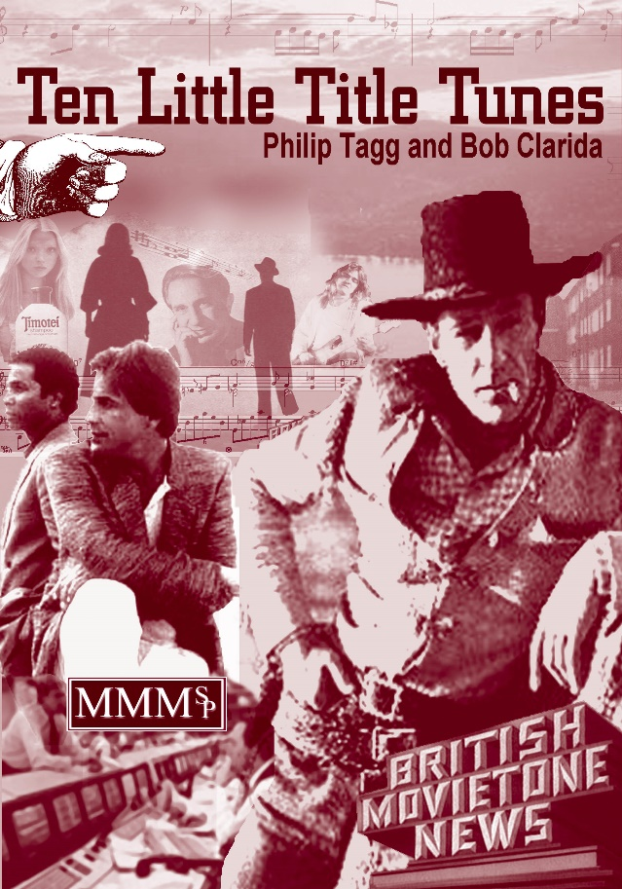
moderating emotion fixation (2)
Proportions of general types of
response given
by 607 subjects
to 10 title tunes
1% evaluative
22% attributives,
emotions, etc.
12% media- immanent
22% time-space, rel., mvt., action, etc.
22% people, beings, objects, etc.
21%
scen-
arios

Slide 30
moderating emotion fixation (3)
References in Ten Little Title Tunes*
NB. These texts have direct links in the hyperink file (slide 30)
VVA Taxonomy | pp. 746-768 / 66-88
2-digit VVA category scores (appendix 5.2) | p. 771/91
3-digit VVA 310-393 (scenarios) | p. 774/94
NB. You will need to navigate manually to the relevant pages
Table ‘Most common VVAs to “male” and “female” tunes (p. 674/692)
Read Ten Little Title Tunes: final chapter ‘So what? Title tune gender and ideology’
Gestural Interconversion
Read article ‘Gestural interconversion and connotative precision’
Play video ‘Olwen, Austria, Shampoo’

Slide 31
GESTURAL INTERCONVERSION
moderating emotion fixation (4)
... a 2-way process by which ...
objects and movements outside the individual are internalised and appropriated by the intermediaries of gesture, touch or bodily movement, as corresponding to particular states of mind;
particular states of mind are, by the same intermediaries, projected on to external objects and movements.
Read article ‘Gestural interconversion and connotative precision’ and/or pp. 253-267 in Ten Little Title Tunes and/or pp. 502-509 in Music’s Meanings.

Slide 32
EMOTION WORDS etc.
moderating emotion fixation (5)
The problem with ‘emotion words’
Too vague for music (e.g. ‘joy’)
Play video ‘5 different types of joy’
Too irrelevantly precise for music (suspicion, envy, jealousy, guilt, embarrassment)
Play video ‘Guilt, suspicion, envy, etc. Which is which?’
Read ‘Emotion, mood, metaphor’ in Music’s Meanings (pp. 71-81)

Slide 33
Why are VVAs useful?
1. They help solve the problem of music’s intrinsically alogogenic (=not conducive to verbalisation) nature in an institutionalised tradition of knowledge where the Word (ὁ λόγος) is king (now).
2. They can help solve an important problem of structural denotation in music — poïetic v. aesthesic. ✓
3. They can help provide descriptors for parameters of expression sidelined by conventional music theory, e.g. timbre, aural space, vocal persona. ✓
4. They help counteract conventional fixation on ‘emotion’ (and ‘the body’) as music’s main semiotic content. ✓

Slide 34
VVAs and the absent sign

Slide 35
the absent sign (1)
P Tagg: Simple semiotics of music
The million-dollar question of music semiotics
sonic materiality
music analysis
Why and how does who
communicate what in music
to whom and with what effect?
social sciences

Slide 36
VVAs and the absent sign (2)
Black box complex
Stereotypical euroclassical music studies
How does who communicate what to whom with what effect?
How does who communicate what to whom with what effect?
Object ― sign ― interpretant
SEMIOSIS
Contextless text «Nothing but ‘the music’»
The
Black Box
of musical meaning
Textless context «Everything but ‘the music’»
Object ― sign ― interpretant
How does who communicate what to whom with what effect?
How does who communicate what to whom with what effect?
Stereotypical cultural studies

Slide 37
VVAs as useful ingredient in developing music semiotics relevant to our times
VVAs and the absent sign (3)
Dual consciousness (Fanon, 1952)*
conflicting sense of identity and agency: public/private, objective/subjective, rational/irrational, etc.
intersubjectivity at basis for media industry and commercial propaganda (‘advertising’).
Play Edward Bernays clip from ‘Century of the Self’
* Frantz Omar Fanon (1952): Black Skin, White Masks. New York (1967). Identity of colonized individual in relation to [1] colonisers, [2] fellow colonised individuals.

Slide 38
“We complacently assume that consciousness is sense and that the unconscious is nonsense.”
(Carl G Jung (1964): ‘Approaching the Unconscious’ in Man and his Symbols. New York, 1968).
Play Adbusters clip ‘The product is you’ [0:15]

Slide 39
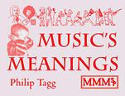
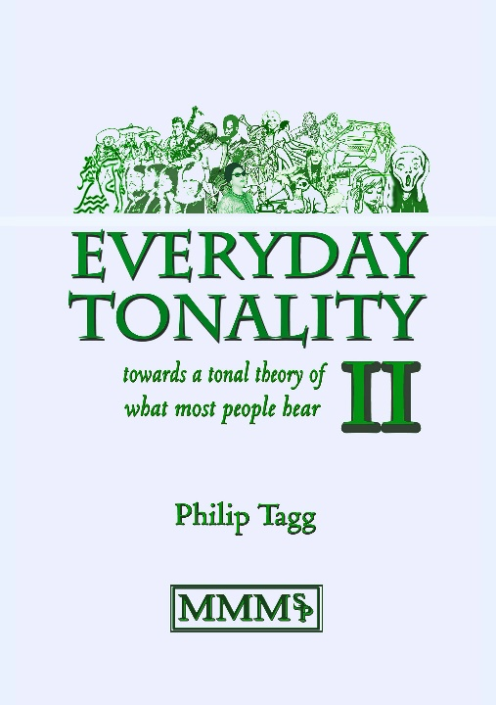
Further information
B
Music’s Meanings: a modern musicology for non-musos (2013)
http://tagg.org/mmmsp/NonMusoInfo.htm
Everyday Tonality II (2015)
http://tagg.org/mmmsp/EverydayTonalityInfo.htm
t
● Dominants and Dominance (2011)
● Musical Learning & Epistemic Diffraction (2011)
● Scotch Snaps: the big picture (2011)
● The Intel Inside Analysis (2010)
● What [the hell] is Tonality? (2015)
http://tagg.org/ptavmat.htm#Video

Slide 40
THE END
Philip Tagg, Huddersfield, Tartu, Belgrade : 2016-09-22 – 2016-10-17 – 2016-11-10
www.tagg.org

