Slide 1
Title
‘I was so Naïve!’
Forty years frustration with music, musicians, musicology and popular music studies.
‘Including MUSIC in Music Studies’ Leeds Beckett University, 2015-01-17
Philip Tagg
www.tagg.org
Notes:
Vids to cue up: [1] FameRockSchools2.mpg; [2] Tonality5.mpg; [3] Arnolfini2.mpg; [4] 007-End-VLC2.mpg ; [5] BernaysAdbust.mpg
Also have ready: NonMusoAll.pdf; FFBk.pdf;Terminology1309.pdf

Slide 2
General overview
1. Naïve: IASPM and Popular Music Studies
The Popular Music Studies establishment[s]
2.The euroclassical establishment
Problems of ethnocentrism and terminology (incl. 20 min video about “Tonality”)
3. Four constructive solutions
[1] demystify music, [2] terminology reform, [3] aesthesic descriptors, [4] semiotics

Slide 3
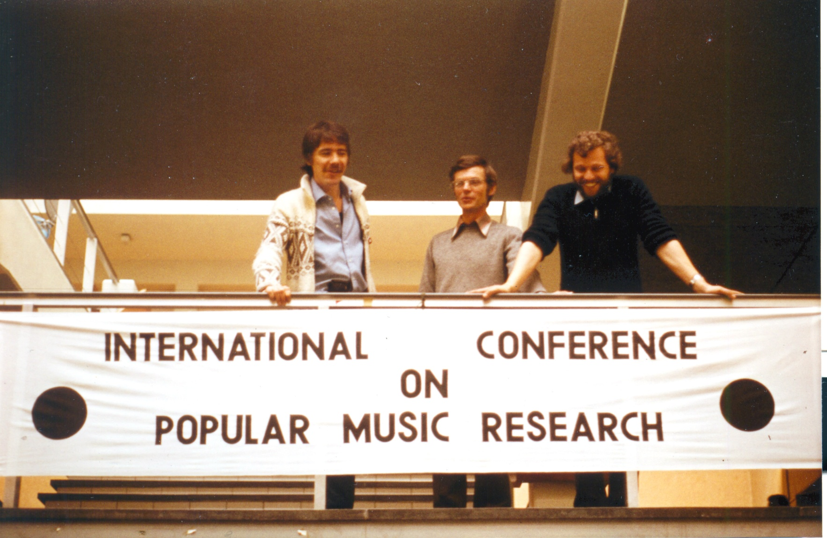
IASPM (Naïve 1)
Philip Tagg, David Horn, Gerard Kempers; Amsterdam, June 1981

Slide 4
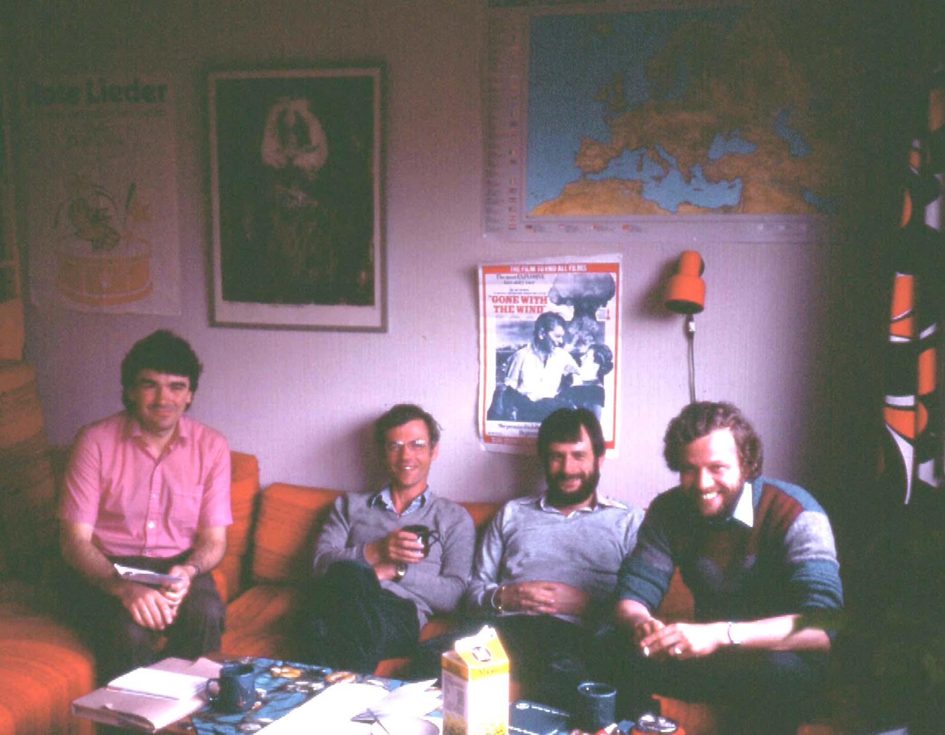
IASPM (Naïve 2)
Simon Frith, David Horn, John Shepherd; chez Tagg, Göteborg, 1983

Slide 5
IASPM Statutes — §2: Aims: naïve?
2.1 The aim of the Association is to provide an international, interdisciplinary and interprofessional organization for promoting the study of popular music. A guiding principle should be that a fair and balanced representation of different continents, nations, cultures and specializations be aimed at in the policy and activity of the Association.

Slide 6
Institutionalisation of musical knowledge (1) (typical, c. 2000)
‘Foreign’, ‘exotic’
Western music cultures
Objects of study →
Euroclass. other
↓ General approach ↓ | Mus. | Soc. | Mus. | Soc. | Mus. | Soc.
Conventional European musicology
Ethnomusicology
sociology, cultural studies
music semiotics

Slide 7
Institutionalisation of musical knowledge (2)
Music as knowledge (knowledge in music)
2. Metamusical knowledge (about music)
P Tagg IbAm08

Slide 8
1. Music as knowledge (knowledge in music)
1a. Poïetic competence (construction)
involves: creating, originating, producing, composing, arranging, performing, etc.
institutionalised in: conservatories, colleges of music, etc.
1b. Aesthesic competence (perception)
involves: recalling & recognising musical sounds, distinguishing between them and between their culturally specific connotations and functions
institutionalised in: ……?
P Tagg IbAm08

Slide 9
2. Metamusical knowledge (knowledge about music)
2a. Metatextual discourse
involves: ‘music theory’, conventional music analysis, identification and naming elements and patterns of musical structure, etc.
institutionalised in: departments of music(ology), colleges of music, etc.
2b. Metacontextual discourse
involves: explaining how musical practices relate to culture and society, incl. approaches from semiotics, acoustics, business studies, sociology, anthropology, etc.
institutionalised in: departments of social science; literature, media, cultural studies.
P Tagg IbAm08

Slide 10
The Popular Music Studies Establishment
The Fame conservatoire
play FameRockSchools2.mpg
Preparing for ‘the industry’? What industry?
Different from the euroclassical or jazz conservatoire? Or just more ‘performing seals’?
Nothing but the music?
2. The ‘cult-stud institution’
Once trendy (1980s-1990s) canons of theory
‘Semiotics is out of date’ (sic!).
‘He has no knowledge of popular music studies.’
Everything but the music: ‘a troublesome appendage to cultural studies’ (Fabbri, 1995)

Slide 11
Popular Music Studies and epistemic problems caused by institutionalisation
Aesthetic prejudices
Did it enter the academy? If so, when and how?
Pre-existing modes of institutionalising knowledge v. the imperative of interdisciplinarity
Scribal and oral traditions, notation and recording
Historically defined and ongoing (‘unfinished’) traditions; temptation to replace old canons with new ones
P Tagg HK 0303

Slide 12
General overview
1. Naïve: IASPM and Popular Music Studies
The Popular Music Studies establishment[s]
2.The euroclassical establishment
Problems of ethnocentrism and terminology (incl. 20 min video about “Tonality”)
3. Four constructive solutions
[1] demystify music, [2] terminology reform, [3] aesthesic descriptors, [4] semiotics

Slide 13
Euroclassical establishment
Ethnocentric
Class-centric
Culturally absolutist
Aesthetically absolutist
Next: a few symptoms of §§1-4
P Tagg IbAm08

Slide 14
Euroclassical establishment. Basic problem 1: scribal/oral, notation/recording
Hegemony of number and written word in academe, of the scribal, of the scopocentric (=fixated on vision) and relative neglect of non-verbal sound (oral/aural).
2. Tendency to privilege parameters of musical expression storable in Western staff notation, developed to encode complexities intrinsic to various forms of Western art music, not those of other music cultures (timbre, micro-inflexion, cross-rhythm, etc.).
P Tagg HK 0303

Slide 15
Euroclassical establishment, basic problem 2: hijacking of ‘music’
Visited 2012-05-03

Slide 16
Sets and subsets (‘music’ / ‘popular music’)
Rain
‘popular’
‘ethno’
‘world’
‘dance’
Hail
‘MUSIC’
PRECIPITATION
Snow
‘contemporary’
‘medieval’
‘jazz’
etc.
‘avant-garde’
‘early’
‘rock’
etc.

Slide 17
Euroclassical establishment, basic problem 3: inadequate structural (esp. tonal) terminology
triads (triadic) v. thirds (tertial)
no coherent theory of quartal tonality
no coherent theory of hexatonicism
dominants & leading notes (ionian [ii-] V-I brainwashing syndrome)
cadence labels (e.g. uninterrupted ‘interrupted', perfect ‘imperfect’ , phrygian finality, etc.)
lack of terms describing unnotated parameters of musical expression (e.g. timbre, vocal persona, cross-rhythm, aural staging, etc.)
chaotic notions of note, tone, tonal, tonality, atonal, modal, modality, etc.
play Tonality5.mpg
P Tagg IbAm08

Slide 18
General overview
1. Naïve: IASPM and Popular Music Studies
The Popular Music Studies establishment[s]
2.The euroclassical establishment
Problems of ethnocentrism and terminology (incl. 20 min video about “Tonality”)
3. Four constructive solutions
[1] demystify music, [2] terminology reform, [3] aesthesic descriptors, [4] semiotics

Slide 19
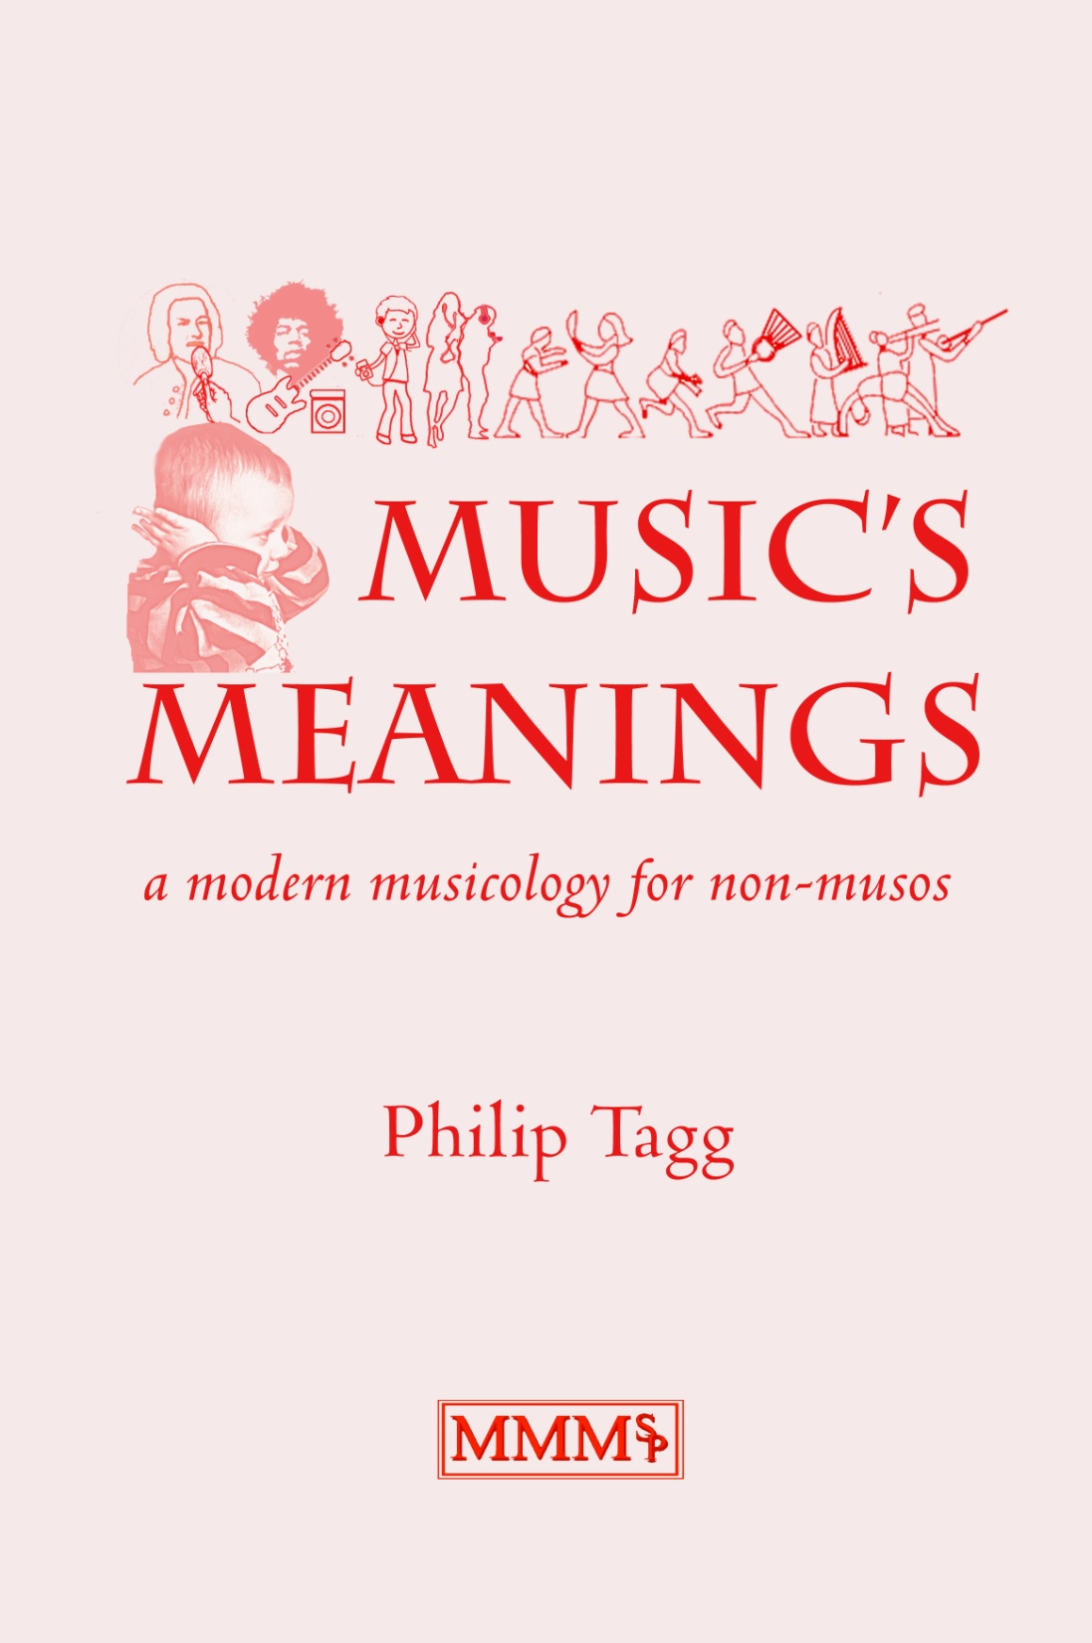
1. Demystification
Chapters 1-4 demystify notions of music (incl. bio-acoustic ‘universals’, music & the brain, emotion, mood, ‘music is music’ (1 & 2), ethno-, socio- and semio- approaches

Slide 20
2. Tonal terminology: examples of reform
Chapters 3-4 on modes (incl. penta-, hexa- & heptatonic; Hijaz, maqams, lydian $7, blues pentatonicism, doh- ré- la- pentatonics, coherent theory of tonical hexatonic modes, etc., not just the ‘usual’ 7!)
Chapters 8-9: tertial harmony ([euro]classical, non-classical; difference triad/third, etc.)
Chapter 10: quartal harmony (no ‘sus’!, shorthand, tonical neighbourhood, ‘11’ chords, quartal classical, quartal jazz, quartal rock, news jingles, folk 4ths and 5ths, etc.)
See also http://tagg.org/terminology/

Slide 21
3. Aesthesic descriptors
Play Arnolfini2.mpg
Unequivocal timecode designation
Play 007-End-VLC2.mpg

Slide 22
4. Semiotics
Why is it so important?

Slide 23
“We complacently assume that the conscious makes sense and that the unconscious is nonsense”¹
Dual consciousness (Fanon, 1952)*
conflicting sense of identity and agency: private/public, subjective/objective, etc.
intersubjectivity at basis for media industry and commercial propaganda (‘advertising’), incl. format radio.
Play BernaysAdbust.mpg [2:18]
Semiotics of popular music (Laing, 1969)²
* Frantz Omar Fanon (1952): Black Skin, White Masks. New York (1967). Identity of colonised individual in relation to [1] colonisers, [2] fellow colonised individuals.
1. Carl Jung, in Jung et al: Man & His Symbols. New York (1994: 92).
2. Dave Laing: The Sound of Our Time. London & Sydney (1969: 194-196).

Slide 24
Semiotic Theory & Method: OVERVIEW
Introductory theory:
▪ Communication model ▪ Basic semiotic terminology ▪ The black box of musical meaning (alogoogeneity, contextless texts and textless contexts) ▪ Genre & style
Intersubjective procedure
Ethnographic observation, reception tests, PMFCs, &c.
Interobjective (intertextual) procedure
IOCM, PMFCs, audio-muscular memory, commutation, ‘reverse engineering’, library music, recommender systems, &c.
Simple sign typology for music analysis
anaphones, diataxemes and style flags
Melody/accompaniment, figure/ground
Transscansions and gestural interconversion
Vocal persona
Notes:
make sure folder D:\temp\Video\Berlin open in Explorer!

Slide 25
C. S. Peirce’s Semiotic Trinity no. 3 aspects of approach after Morris
Syntax
Internal (etic) organisation and arrangement of structural elements without necessarily considering their meaning
‘La sintattica e la semantica, quando si trovano in splendido isolamento, diventano… discipline “perverse”’ .*
Semantics
Links between signs and what they represent (emic) without necessarily considering their use in concrete situations
‘Historicismus wie musikalische Hermeneutik weisen hin auf der Leerstelle, die von einer musikalischen Pragmatik aufzufüllen ist.’**
Pragmatics
Use of signs in concrete sociocultural situations
* ‘Syntax and semantics, when found in splendid isolation, become “perverse” disciplines’. (Umberto Eco: I limiti dell’interpretazione, p. 259; Milan 1990).
** ‘Historicism and hermeneutics both draw attention to the gap that has to be filled by musical pragmatics’. (Chr. Hubig: in Musikalische Hermeneutik, ed. C. Dahlhaus, p. 122; Regensburg, 1975).

Slide 26
Denotation and connotation
Denotation
Type of lexical meaning associated mainly with arbitrary signs
thunder (the word) = noise accompanying lighting  diminished seventh chord = chord consisting of three contingent and superimposed minor thirds
Connotation
Non-lexical type of meaning mainly associated with indices and which relies on one or more previous levels of semiosis
thunder (the sound) = humidity, rain, danger, etc. diminished seventh chord = horror, 19th-century style

Slide 27
Connotation & ‘polysemy’ : 2 quotes
‘The difference between denotation and connotation is not... the difference between “univocal” and “vague” signification, or between “referential” and “emotional” communication... What constitutes a connotation... is the connotative code which establishes it; the characteristic of a connotative code is the fact that the further signification... relies on a primary one.’
(Eco, A Theory of Semiotics, 1979, p. 55)
‘The thoughts which are expressed to me by a piece of music which I love are not too indefinite to be put into words, but on the contrary too definite.’
(Mendelssohn, cited by Cooke: The Language of Music, 1959, p. 5)

Slide 28
Connotation: smoke alarm sound = danger! multilevel semiosis (3 causal indices, 1 connotation)
sign
interpretant
sign
interpretant
DANGER!
GET OUT!
DON’T DIE!
sign
interpretant
alarm sound
smoke
fire
1. Smoke triggers alarm; alarm means smoke (causal index 1)
2. Fire causes smoke; smoke means fire (causal index 2)
3. Fire destroys and hurts; a fire in the home means danger (index 3)

Slide 29
Institutionalisation of musical knowledge (1) (typical, c. 2000)
‘Foreign’, ‘exotic’
Western music cultures
Objects of study →
Euroclass. other
↓ General approach ↓ | Mus. | Soc. | Mus. | Soc. | Mus. | Soc.
Conventional European musicology
Ethnomusicology
sociology, cultural studies
music semiotics

Slide 30
Black box simple
Conventional music studies
The
Black Box
of musical meaning
Conventional cultural studies

Slide 31
Black box complex
Stereotypical euroclassical music studies
How does who communicate what to whom with what effect?
How does who communicate what to whom with what effect?
Object ― sign ― interpretant
SEMIOSIS
Contextless text
The
Black Box
of musical meaning
Textless context
Object ― sign ― interpretant
How does who communicate what to whom with what effect?
How does who communicate what to whom with what effect?
Stereotypical cultural studies

Slide 32
Simple semiotics of music
Chapter 5: basic semiotics
Chapter 6: intersubjectivity
Chapter 7: interobjectivity
Chapter 8: time & space
Chapter 9: timbre, loudness, tonality
Chapter 10: vocal persona
Chapter 11: diataxis
Chapter 12: syncrisis
Chapter 13: sign typology
Chapter 14: film music analysis

Slide 33
THE END
Philip Tagg, Huddersfield 2015-01-15
www.tagg.org

