Slide 1
Title
Troubles with Tonal Terminology
…on the de-ethnocentrification of structural terminology
Philip Tagg Visiting Professor, Universities of Huddersfield and Salford (UK)
www.tagg.org
Prepared for the
XII Congreso SIBE ― Sonidos del presente, propuestas de futuro Investigación, innovación y aprendizaje en las músicas populares urbanas y de tradición oral
Universidad de Extremadura, 8 November 2012
Notes:
make sure folder D:\temp\Video\Berlin open in Explorer!

Slide 2
Overview presentation overview as intended 2012-11-08
Popular Music Studies (PMusStuds)
Troubles with terminology (general)
non-notatable parameters
poïesis v. aesthesis
what is form?
De-ethnocentrifying tonal terminology
tonality, modality, bimodality, (non-) directionality, etc.
PMusStuds: ethno, socio and semio approaches
Conclusions

Slide 3
Uno objectivo principal con esta presentación
Demostrar la necesidad de una reforma termino-lógica y metodológica en los estudios musicales.
razones
Omnipreséncia y importáncia de música en la sociedad contemporánea (>4 horas o €3 per diem).
Democratización de los estudios musicales (los ‘no-musicos’); los parámetros de expresión no-transcriptibles (timbre, persona vocal, espacio sónico, etc.).
Globalización musical: ej. España y Gran Bretaña, antes qué la Europa Central, + músicas africanas y indígenas; riesgos etnocéntricos, clas-céntricos y colonialistas.
Evitar el estanamiento de la teoria musical y la alienación de nuestros estudiantes.

Slide 4
Subjects taught 1971-2010
(38½ years)
Popular Music History
Popular Music Analysis
Music and the Moving Image
Approaches to the Study of Popular Music

Slide 5
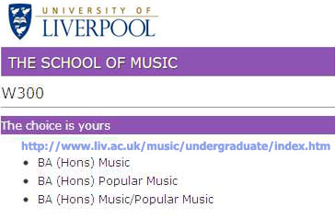
Visited 2012-05-03

Slide 6
Guess these three numbers
127
14
0
Total # musicologists employed in Italian universities in 2008
of which ethnomusicologists
of which popular music specialists
1
(2009)

Slide 7
Overview presentation overview as intended 2012-11-08
Popular Music Studies (PMusStuds)
Troubles with terminology (general)
non-notatable parameters
poïesis v. aesthesis
what is form?
De-ethnocentrifying tonal terminology
tonality, modality, bimodality, (non-) directionality, etc.
PMusStuds: ethno, socio and semio approaches
Conclusions

Slide 8
Popular Music Analysis: structural denotation
Graphocentrism
‘Work’ or ‘text’ (music in dormant mode) as something written
Notatable parameters at expense of others (e.g. timbre, metricity, aural staging)
Poïetic v. aesthesic descriptors

Slide 9
Parameters of musical expression and storage media
Parameters
Notation
HiFi stereo recording
Tonality (pitch, register, melody, harmony, etc.)
Timing (tempo, surface rate, rhythm, metre, etc.)
Loudness (dynamics, volume, accentuation, etc.)
Timbre (incl. instrumentation, articulation)
Spatiality

Slide 10
Overview presentation overview as intended 2012-11-08
Popular Music Studies (PMusStuds)
Troubles with terminology (general)
non-notatable parameters
poïesis v. aesthesis
what is form?
De-ethnocentrifying tonal terminology
tonality, modality, bimodality, (non-) directionality, etc.
PMusStuds: ethno, socio and semio approaches
Conclusions

Slide 11
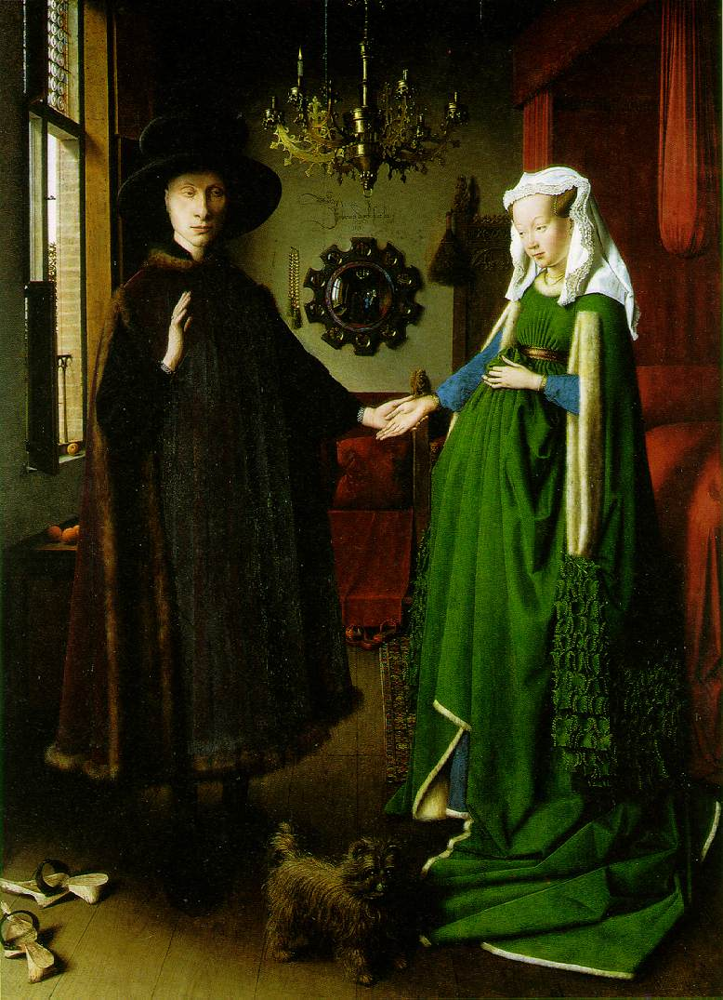
Arnolfini
Van Eyck: The Marriage of Giovanni Arnolfini and Giovanna Cenami; 1434; Oil on wood, 81.8 x 59.7 cm; National Gallery, London.
Denoting structure in visual art
dog
aesthesic descriptor

Slide 12
007
Monty Norman (arr. John Barry): 007 (James Bond Theme), 1962: final chord
Denoting structure in music (1)
dog?
No!
Em^{Δ}9
E minor major nine (E minor triad with added major seventh and ninth)
E minor triad with superimposed B major triad
Tonic minor triad with superimposed dominant major triad
on a Fender Stratocaster (type of electric guitar) treated with slight tremolo and some reverb
Poïetic descriptors
P Tagg AaUni1111

Slide 13
007b
Monty Norman (arr. John Barry): 007 (James Bond Theme), 1962: final chord
Denoting structure in music (2)
Em^{Δ9}?
Not essential!
Detective chord
Why not?
Spy chord
The James Bond chord
Aesthesic descriptors
P Tagg AaUni1111

Slide 14
Poïetic or aesthesic?
Informant accessibility
Informant numbers (statistical reliability?)
Authorial intention or end users as the final arbiters of musical meaning?
Risks of auteurcentric focus
Alive? Accessible? ― ‘Music speaks for itself’ (guild mentality)
Muso self-image and the ‘next gig’
Easily identified subjects v. ‘faceless masses’ (audiences)
Individual or collective subjectivity (intersubjectivity).

Slide 15
1. Music as knowledge (knowledge in music)
1a. Poïetic competence (construction)
involves: creating, originating, producing, composing, arranging, performing, etc.
institutionalised in: conservatories, colleges of music, etc.
1b. Aesthesic competence (perception)
involves: recalling & recognising musical sounds, distinguishing between them and between their culturally specific connotations and functions
institutionalised in: ……?
P Tagg IbAm08

Slide 16
2. Metamusical knowledge (knowledge about music)
2a. Metatextual discourse
involves: ‘music theory’, conventional music analysis, identification and naming elements and patterns of musical structure, etc.
institutionalised in: departments of music(ology), colleges of music, etc.
2b. Metacontextual discourse
involves: explaining how musical practices relate to culture and society, incl. approaches from semiotics, acoustics, business studies, sociology, anthropology, etc.
institutionalised in: departments of social science; literature, media, cultural studies.
P Tagg IbAm08

Slide 17
Overview presentation overview as intended 2012-11-08
Popular Music Studies (PMusStuds)
Troubles with terminology (general)
non-notatable parameters
poïesis v. aesthesis
what is form?
De-ethnocentrifying tonal terminology
tonality, modality, bimodality, (non-) directionality, etc.
PMusStuds: ethno, socio and semio approaches
Conclusions

Slide 18
Form: qu’est-ce que c’est?
“form /fo:m/ n. 1 a
a shape; an arrangement of parts” (Concise Oxford Dictionary, 1995)
“the shape and structure of something as distinguished from its material” (Merriam-Webster, online 121005)

Slide 19
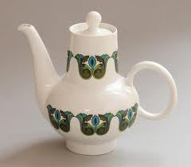
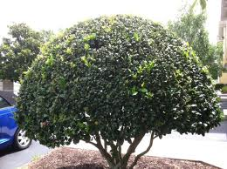
Visual “form” (‘composition’, ‘shape’, etc.)
synchronic, intensional
Musical “form” (‘composition’?)
Exposition | Exposition | Development | Recapitulation
Chorus | Chorus | Middle 8 | Chorus
A | A | B | A
diachronic, extensional

Slide 20
Isn’t this musical form?
4” loop, identification jingle for YouTube video The Scotch Snap (2011)
The extended present (a.k.a. ‘specious present’)
Bagpipe sample drone 1-5-1
Sub-Saharan time line 1
Bagpipe doubled (offset, detuned)
Sub-Saharan time line 2
Sanza/mbira/marimba sample
Bass line
2 main types of
musical form
SYNCRISIS, syncritic form
synchronic, intensional (‘vertical’, ‘texture’)
DIATAXIS, diatactical form
diachronic, extensional (‘horizontal’, ‘narrative’)

Slide 21
Overview presentation overview as intended 2012-11-08
Popular Music Studies (PMusStuds)
Troubles with terminology (general)
non-notatable parameters
poïesis v. aesthesis
what is form?
De-ethnocentrifying tonal terminology
tonality, modality, bimodality, (non-) directionality, etc.
PMusStuds: ethno, socio and semio approaches
Conclusions

Slide 22
Tonal Terminology
Aspects of musical structure compatible with Western notation:
i.e. a system of graphic representation developed to encode mainly monometric music whose pitches conform to the twelve notes of our chromatically divided octave.
(a very small % of all music in the world)
Please see Troubles with Tonal Terminology (2011) at www.tagg.org/xpdfs/Aharonian2011.pdf

Slide 23
Some problem terms
tone
tonic
tonal
tonality
modality
pretonal
post-tonal
atonal
dominant
subdominant
relative major/minor
modulation
perfect cadence
half cadence
plagal cadence
interrupted cadence

Slide 24
Montage: 11 extracts
Play D:\temp\Video\Berlin\ RomeMontageV2.mpg

Slide 25
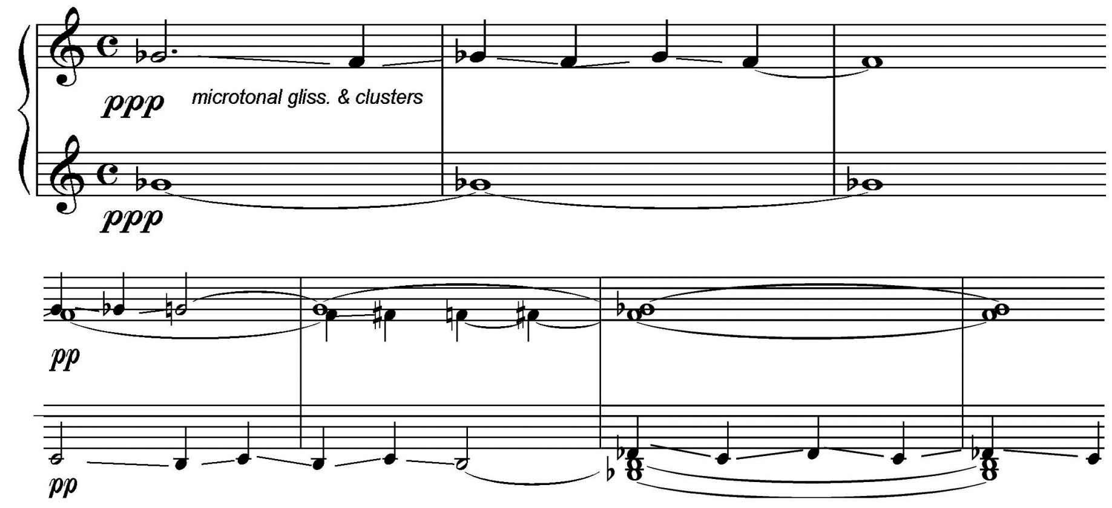
‘Atonal’?!? Mission underscore at 0:00:45 (Morricone)

Slide 26
Linguistic derivative pattern
comic | comical | clinic | clinical
ethic[s] | ethical | magic | magical
music | musical | optic | optical
polemic | polemical | rhetoric | rhetorical
statistic | statistical | tropic[s] | tropical
TONIC TONICAL – TONICALITY

Slide 27
Chordal mystery category
TERTIAL
QUARTAL
‘triadic’? ‘functional’ ? ‘diatonic’?

Slide 28
3 categories of tonical tertial harmony
Euroclassical tertial harmony
Non-classical ionian tertial harmony
Non-ionian tertial harmony

Slide 29
Montage: Non-classical ionian tertial harmony (1) Parallel fifths and octaves (2) Ionian bitonical shuttles (shuttle = “lanzadera”, “vaivén”)
Play E:\Video\ IonianNonClassical.mpg

Slide 30
From ionian/mixolydian to bimodality. [1] Who’s Gonna Build Your Wall? [2] Ionian-æolian bimodality [3] Æolian-phrygian bimodality Extracts from Dominants and Dominance (Dominantes y dominación) http://www.youtube.com/watch?v=rWlt9Is1nms
Play E:\Video\Bimodality2.mpg (15 mins)

Slide 31
Overview presentation overview as intended 2012-11-08
Popular Music Studies (PMusStuds)
Troubles with terminology (general)
non-notatable parameters
poïesis v. aesthesis
what is form?
De-ethnocentrifying tonal terminology
tonality, modality, bimodality, (non-) directionality, etc.
PMusStuds: ethno, socio, semio approaches
Conclusions

Slide 32
Typical topics for 4 general approaches to studying music (c. 2000)
‘Foreign’, ‘exotic’, cultures
Western music cultures
Objects of study →
Euroclassical other
↓ General approach ↓ | Mus. | Soc. | Mus. | Soc. | Mus. | Soc.
Conventional European musicology
Ethnomusicology
sociology, cultural studies
music semiotics

Slide 33
Importance of ‘ethno’ to popular music studies 1 (3)
1877: Edison invents phonograph
1889: Recordings of native N-American music
1900: Stumpf records Thai music in Berlin
1904: Bartók & Kodály record in Transylvania
1924: Patent on electro-magnetic recording
1926-: “Hillbilly” and blues recorded by Peer, Lomax, &c. ― effective start of popular music recording industry ―
1960-: UNESCO recordings issued on vinyl

Slide 34
Importance of ‘ethno’ to popular music studies 2 (3)
1. Tonal and temporal structures unstorable in our notation system. Sound recording replaces notation as principal source of documentation.
2. Non-notatable parameters of expression (timbre, cross-rhythm, etc.) no longer excluded from documentation. Challenge to the primacy of notatable parameters.
3. Recordings of non-euroclassical music: unwritten repertoires become available to everyone; no more note-reading required to hear any sort of music.
4. Diffusion of a wide variety of musical sounds with sociocultural functions and aesthetic values different from those of the euroclassical repertoire; impossible to maintain the superiority of just one set of musical rules and values.
5. “Their” music remains a mystery to “us” if not explained in context of its socio-cultural uses. Musical absolutism (“music is music”) becomes impossible. Consideration of music’s uses underlines importance of the aesthesic pole and challenges conventional auteurcentrism.

Slide 35
Importance of ‘ethno’ to popular music studies 3 (3)
Knowledge of other musics provokes questions about our own.
If, to unerstand “their” music, we need to know about its socio-cultural context, what would “they” need to know about our culture to understand the sounds and customs of our music?
How do “our” musics function anthropologically?
Why is there no ethnomusicology of the euroclassical?
Why is there so little ethnomusicology of other musics in our culture?
Are “we” not also part of an εθνος? Am I not an ανθρωπος?
If not, why not?

Slide 36
The importance of ‘socio’
Sociology: 1st discipline to take popular music seriously.
Sociology, theoretical/critical or empirical, helps establish PMusStuds as a valid area of research for social science scholars interested in cultural and ideological matters (whence strong representation of Cultural Studies in PMusStuds).
Empirical sociology provides statistics about musial habits. Useful info when questioning anti-democratic cultural and educational policies.
Frankfurt School notions of “authenticity” resurface in the “oppositional” discourse of 1960s rock journalists (the transfigured ghost of Adorno via Marcuse).
P Tagg 2006

Slide 37
Importance of music semiotics
Dual consciousness (Fanon, 1952)*
conflicting sense of identity and agency: private/public, subjective/objective, etc.
intersubjectivity at basis for media industry and commercial propaganda (‘advertising’).
Semiotics of popular music (Laing, 1969)¹
* Frantz Omar Fanon (1952): Black Skin, White Masks. New York (1967). Identity of colonised individual in relation to [1] colonisers, [2] fellow colonised individuals.
1. Dave Laing: The Sound of Our Time. London & Sydney (1969: 194-196).

Slide 38
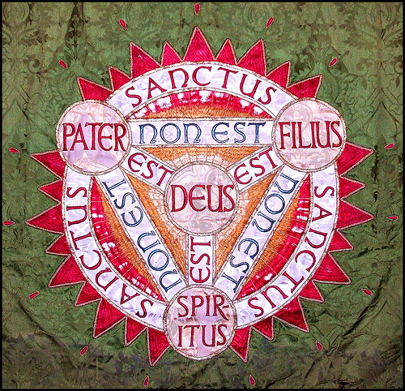
Peircian Trinities
In nomine
patris et filii et spiritūs sancti
Firstness | Secondness | Thirdness
Object | Sign | Interpretant
Syntax | Semantics | Pragmatics
Icon | Index | Arbitrary sign

Slide 39
C. S. Peirce’s Semiotic Trinity no. 3 aspects of approach after Morris
Syntax
Internal (etic) organisation and arrangement of structural elements without necessarily considering their meaning
‘La sintattica e la semantica, quando si trovano in splendido isolamento, diventano… discipline “perverse”’ .*
Semantics
Links between signs and what they represent (emic) without necessarily considering their use in concrete situations
‘Historicismus wie musikalische Hermeneutik weisen hin auf der Leerstelle, die von einer musikalischen Pragmatik aufzufüllen ist.’**
Pragmatics
Use of signs in concrete sociocultural situations
* ‘Syntax and semantics, when found in splendid isolation, become “perverse” disciplines’. (Umberto Eco: I limiti dell’interpretazione, p. 259; Milan 1990).
** ‘Historicism and hermeneutics both draw attention to the gap that has to be filled by musical pragmatics’. (Chr. Hubig: in Musikalische Hermeneutik, ed. C. Dahlhaus, p. 122; Regensburg, 1975).

Slide 40
Black box complex
Stereotypical euroclassical music studies
How does who communicate what to whom with what effect?
How does who communicate what to whom with what effect?
Object ― sign ― interpretant
SEMIOSIS
Contextless text
The
Black Box
of musical meaning
Textless context
Object ― sign ― interpretant
How does who communicate what to whom with what effect?
How does who communicate what to whom with what effect?
Stereotypical cultural studies

Slide 41
Absent pragmatics in music semiotics
88
Total number of articles in 3 volumes of learned semio-musicological texts (1987-1998).
59
articles (67%) deal with overriding theoretical systems or with musical syntax (usually diataxis)*.
29
articles (33%) include semantic issues but only 3 (3.4%) deal with pragmatics, with focus on poïesis rather than aesthesis.

Slide 42
Black box fast
The
Black Box
of musical meaning

Slide 43
Que faire?
1. Non-musos (Cultural/Media Studies, Sociology, etc.)
―identify SIGN by including musical STRUCTURE
aesthesic descriptors
unequivocal time code placement
musematic analysis procedure
2. Musos (musicians, musicologists, etc.)
―identify SIGN by including INTERPRETANT
aesthesic descriptors
unequivocal time code placement
musematic analysis procedure

Slide 44
Unequivocal time code placement (007)
Play E:\Video\UnequivDesign2.mpg

Slide 45
Black box 2
Basics of Musematic Analysis
Musical analysis object
(AO)
Sorry! Out of time…
See chapters 5-7, 13
in Music’s Meanings
http://www.tagg.org/mmmsp/NonMusoInfo.htm/

Slide 46
Overview presentation overview as intended 2012-11-08
Popular Music Studies (PMusStuds)
Troubles with terminology (general)
non-notatable parameters
poïesis v. aesthesis
what is form?
De-ethnocentrifying tonal terminology
tonality, modality, bimodality, (non-) directionality, etc.
PMusStuds: ethno, socio, semio approaches
Conclusions

Slide 47
Conclusions 1 (2)
Please recognise two aspects of musical form: synchronic (syncrisis) and diachronic (diataxis).
Please distinguish between tone and tonic, tonal and tonical, atonal and atonical.
Please distinguish between triad and third, as well as between triadic and tertial.
Please recognise the existence and validity of multiple tonalities’ including those with more than one tonic.
Avoid nonsense terms like ‘pretonal’ and ‘post-tonal’.
All modes are by definition tonal. It is ahistorical and illogical not to treat also the ionian as a mode.

Slide 48
Conclusions 2 (2)
Please do not reduce tonal directionality, or its absence, to the poverty of Riemannesque/Schenkerian precepts.
Combat tonal impoverishment by understanding how different tonal vocabularies actually wok, e.g. $II>I!
Please consider the advantages of using aesthesic descriptors to designate musical structure.

Slide 49
What to do (1)
Ostrich strategy. ‘Nothing is wrong’. Carry on as usual. ‘We may be in the minority but we’re always right.’
Defeatist (‘realist’) strategy. Take note but no action: ‘interesting; some valid points but we have to deal with music theory “as is”. You can’t change >100 years of dubiously ethnocentric labelling. Get used to it!’
Tokenist strategy. ‘We’re broad-minded and modern. We have ethnomusicology and/or popular music studies and/or music technology on the curriculum but we see no need to change the basics of music theory.
Laissez-faire (‘anti-authoritarian’) strategy. New terms are as bad as old ones. You’re forcing everyone to think like you. Let things develop organically.

Slide 50
What to do (2)?
Risk alienation from conservative musicology
(both ancient and modern) by making life easier for the popular majority of students through:
- simple reform of a few basic terms;
- recognition of vernacular musical competence;
- reintegration of music as a specific form of
symbolic production on a par with others.

Slide 51
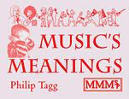
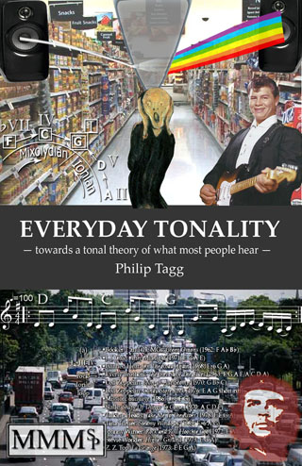
Further information
Music’s Meanings: a modern musicology for non-musos (2012)
tagg.org/mmmsp/publications.html
Everyday Tonality (2009)
tagg.org/mmmsp/publications.html
Dominantes y Dominación
Musical Learning & Epistemic Diffraction
Scotch Snaps: the big picture
The Intel Inside Analysis

Slide 52
THE END
Philip Tagg, Cáceres, 7 November 2012
www.tagg.org

Slide 53
Main model
AO
Analysis Object
IOCM
Interobjective Comparison Material
2a
Escaping from
the intramusical prison
2b
1
PMFC
Paramusical Fields of Connotation (relevant to AO)
PMFC
Paramusical Fields of Connotation (relevant to IOCM)

Slide 54
AO
Analysis Object
1. Ethnographic observation
audience & demographics, cultural location, behaviour, reactions, uses
2. Paramusical expression
lyrics, action, images, story, gesture, dance, movement, liner notes, programme notes, reviews, opinions, written descriptions, etc.
3. Reception tests
Some considerations:
PMFC
Paramusical Fields of Connotation (relevant to AO)
Reception demographics
Oral or written?
Classroom or internet?
Multiple choice or free induction?
Listening mode
Response interpretation procedure

Slide 55
AO
Analysis Object
IOCM
Interobjective Comparison Material
intertextuality
Other music sounding in some way similar to the AO
Other music as ‘hypertext’ or ‘metalanguage’ for music
How to find this ‘other music’?
Why bother looking for it?

Slide 56
AO
Analysis Object
IOCM
Interobjective Comparison Material
Why bother looking?
Because music resembles music
more than anything else.
Because music is associated
with other stuff
PMFC
Paramusical Fields of Connotation (relevant to IOCM)

Slide 57
AO
Analysis Object
IOCM
Interobjective Comparison Material
How to find IOCM
ASK A MUSICIAN: audio-muscular memory (with caveat)
RECOMMENDER SYSTEMS (iTunes, Last.fm, Pandora, etc.)
LIBRARY MUSIC COLLECTIONS
REVERSE ENGINEERING 1 (find IOCM from hypotheses)
REVERSE ENGINEERING 2 (recompose AO from hypotheses)

Slide 58
AO
Analysis Object
IOCM
Interobjective Comparison Material
Why bother looking?
Because music resembles music more than anything else.
Because music is associated with other stuff…
1. Ethnographic observation
audience & demographics, cultural location, behaviour, reactions, uses
PMFC
Paramusical Fields of Connotation (relevant to IOCM)
2. Paramusical expression
lyrics, action, images, story, gesture,
dance, movement, liner notes,
programme notes, reviews,
opinions, written descriptions, etc.

Slide 59
AO
Analysis Object
IOCM
Interobjective Comparison Material
1. If
2. and if
3. then
(hypothesis, see next slide)
PMFC
Paramusical Fields of Connotation (relevant to IOCM)

Slide 60
Main model2
AO
Analysis Object
IOCM
Interobjective Comparison Material
PMFC
Paramusical Fields of Connotation (relevant to AO)
PMFC
Paramusical Fields of Connotation (relevant to IOCM)

Slide 61
Simplified sign typology
sonic: perceived similarity to paramusical sound
anaphone
kinetic/spatial: perceived similarity to paramusical movement, incl. senses of time and space
principally iconic,
‘sounds like’…
tactile: perceived similarity to paramusical sense of touch, grain, texture
social: perceived similarity to size and type of (social) group
composite: similarity using several modes of perception
diataxeme
iconic and/or indexical: episodic determinants, episodic markers, diatactical form
style flag
mostly indexical: style indicators and genre synecdoches

Slide 62
Overview presentation overview as intended 2012-10-25
The Monelle connection
Popular Music, pragmatics and semiosis
Poïesis v. aesthesis
Basics of musematic analysis
Troubles with terminology
tonal, formal, timbral, vocal
Conclusions
Notes:
make sure E:\PTSys\BAT\PptVclRoma.BAT is running simultaneously!

Slide 63
3 useful concepts (1)
TRANSCANSION
from trans = across and scandere = climb/scan
type of sonic anaphone (musical sign type)
involving the transfer of the prosodic (scanable)
elements (rhythm, accentuation, intonation) and
timbral qualities of a word or words from speech
into music according to similar principles as
those used for talking drums.

Slide 64
3 useful concepts (2)
GESTURAL INTERCONVERSION
... a 2-way process by which ...
objects and movements outside the individual are internalised and appropriated by the intermediaries of gesture, touch or bodily movement, as corresponding to particular states of mind;
particular states of mind are, by the same intermediaries, projected on to external objects and movements.

Slide 65
Overview presentation overview as intended 2012-10-25
The Monelle connection
Popular Music, pragmatics and semiosis
Poïesis v. aesthesis
Basics of musematic analysis
Troubles with terminology
tonal, formal, timbral, vocal
Conclusions
Notes:
make sure E:\PTSys\BAT\PptVclRoma.BAT is running simultaneously!

Slide 66
3 useful concepts (3)
VOCAL PERSONA
from personare = to sound through, as of the character’s voice behind the actor’s mask in ancient drama
personality, often archetypal, conveyed
primarily by non-verbal vocal means.

Slide 67
Vocal persona (quote)
‘[L]isteners who hear voice samples can infer the speaker’s socio-economic status…, personality traits,… and emotional and mental state…
Listeners exposed to voice samples are also capable of estimating the age, height, and weight of speakers with the same degree of accuracy achieved by examining photographs…
Independent raters are also capable of matching a speaker’s voice with the person’s photograph over 75% of the time.’
Hughes, Susan M et al. (2004). ‘Ratings of voice attractiveness predict sexual behavior’. Evolution and Human Behavior, 25: 295–304

Slide 68
Vocal persona characteristics (quotes)
hard-edged sexual exuberance
Eminem
Wilson Philips
Linda Ronstadt
Buddy Holly
Chaka Khan
Katryna (Nields)
Beverly Sill
impish chirp
Barbie dolls
cuddly vocal personality
nervous teenage male, fearful of rejection
angry smurf
Western mythical girl/woman, heartbroken yet resilient and entirely feminine

Slide 69
General types of vocal descriptor
poïetic
how sounds are produced: breathing, control, projection, register, posture, nose, head, chest, diaphragm, etc.
acoustic
volume, dynamics, intensity, partials, transients, fundamentals, amplitude, etc.
aesthesic
perceived traits: sound descriptors, transmodal metaphors, personae

Slide 70
Aesthesic voice description categories (1)
1. Sound descriptors
e.g. babble, bark, bawl, bellow, bleat, boom, chatter, chuckle, chirp, cluck, complain, cry, declaim, denounce, drone, exclaim, gasp, giggle, growl, grumble, gurgle, hoot, howl, hum, laugh, lilt, moan, mumble, mutter, proclaim, rasp, recite, roar, scream, shout, shriek, sigh, snarl, snigger, snort, sob, spit, splutter, squawk, squeak, stammer, stutter, wail, warble, weep, wheeze, whimper, whisper, whistle, whoop, yammer, yap, yell, yelp, etc.
High-pitched, low-pitched, deep, full-throated, gruff, breathy, husky, nasal, gutteral, distinct, indistinct, harsh, muffled, hoarse, shrill, monotone, etc.
2. Transmodal (anaphonic/synaesthetic) descriptors
e.g. sweet, smooth, rough, rounded, sharp, angular, velvety, scratchy, piercing, clean, clear, shaky, wobbly, brassy, grainy, gravelly,

Slide 71
Aesthesic voice description categories (2)
3. Persona descriptors (a-c: d on next slide)
a) Named persons
• Sean Connery, Clint Eastwood, Morgan Freedman; • Billy Holiday, Kate Bush, Björk, etc.
b) Demographic
• man, woman, boy, girl, old, young, middle-aged • language, dialect, regional/class accent, etc.
c) Emotional
• cute, cuddly, sweet, nice; • wise, confident, etc.
• melancholy, bored, bland, nondescript, neutral
• willful, determined, brave; • bubbly, cheeky, cheery, jaunty, etc.
• hip, cool, seductive; • sardonic, sarcastic, ironic, nasty, evil
• vulnerable, embarrassed, scared, edgy, nervous, angry, frustrated
• depressed, sad, alienated, anguished, desperate, suicidal, etc., etc.

Slide 72
Aesthesic voice description categories (3)
3. Persona descriptors (d): professions, roles, archetypes
alien, Barbie doll, big boss, bitch, elder, evil child, evil queen,
dirty old man, Druid, fat cat, father, football hooligan, gangster,
geek, guide, heroine, hero, imp, lager lout, miser, monster, mother,
nerd, priest, princess, robot, sissy, soldier, teenager, vamp, villain,
wiseguy, witch, etc.
combinations of 3a, b and c with some vocal costume elements (next)

Slide 73
Vocal persona (4)
3. Vocal costume
cf. swimming costume, actor’s costume, military or school uniform national/regional costume, etc.
costume = something worn, for practical or conventional reasons, to carry out a particular activity, or to show an identity
Spoken costumes
for example • telephone voice (1950s) • ‘interactive’ voice ‘recognition’ (Claire, Julie, Emily, Taxi 8585) • public speaking voice, primary school teacher voice
Sung costumes
for example • bel canto, Wagner soprano, heroic tenor, opera buffa bass • blues shouter, folk singer, crooner, rock yeller/screamer

Slide 74
Palavra de mulher (audio)
Start E:\Video\PalavraMulher160.mp3 and advance to next slide to display lyrics line by line.

Slide 75
Palabra de mulher (1)
&
Elba Ramalho (v); Chico Buarque (w); Tom Jobim (m)
0:00 Intro. Tonic chord (Am^{add9})
strings (D)
0:30 Am^{add9}
0:35 Vou voltar, eu juro que vou voltar. Já te dexei, I’ll be back, I promise I’ll be back. I already showed you,
0:44 jurando nunca mais olhar para atrás, palabra de mulher, eu vou voltar. vowing I’d never look back; a woman’s word: I will return [to you].
0:54 Posse até sair de bar em bar em bar em bar, Then I might go out from bar to bar to bar and
0:58 falar besteira, e me engagnar com qualquer um talk nonsense, getting mixed up with someone or other
1:07 e me deitar a noite inteira. Eu vou te amar. and spending the whole night there. I will love you.

Slide 76
Palabra de mulher (2)
Vou chegar a qualquer hora ao meu lugar, Some time I will arrive at my place
E si uma outra pretender um dia te roubar, dispense a vadia, vou voltar. And if another woman tries to steal you, send that bitch away, I ‘ll be back.
Vou subir a nossa escada (× 3), meu amor, I will climb our stairs, stairs, stairs, my love.
Eu vou partir de novo feito viciada, eu vou voltar. Spoilt [by you] I’ll leave again, I will come back.

Slide 77
Palabra de mulher (3)
Pode ser que a nossa história seja mais: Maybe our story will go on:
Uma quimera e pode o nosso teto, o Lapa o Rio disabar. An illusion, and maybe our roof or Lapa or Rio will crumble.
Pode ser que passe o nosso tempo como um qualquer prima vera. Maybe our time will pass like some spring season.
Espera, me espera, eu vou voltar. Wait, wait for me, I will come back.

Slide 78
Conclusions (incl. some axioms)
Listeners/users are the final arbiters of musical meaning.
Interpretants can be used to label musical structures aesthesically ―espcially useful for those determined by parameters of expression for which musicology has developed little or no precise vocabulary; also useful for minimising muso ‘gobbledygook’ in multi-media and multidisciplinary contexts.
Systematised non-muso-friendly music labels are in widespread use (e.g. systematised by library music collections) but rarely exploited by music semioticians. Why not?

Slide 79
Further information
Music’s Meanings: a modern musicology for non-musos (2012)
tagg.org/mmmsp/publications.html
Everyday Tonality (2009)
tagg.org/mmmsp/publications.html
Dominantes y Dominación
Musical Learning & Epistemic Diffraction
Scotch Snaps: the big picture
The Intel Inside Analysis

Slide 80
THE END
Philip Tagg, Edinburgh, 7 November 2012
www.tagg.org

